Slide 1


Presented By -
Faria Binta Awal - 1905012
Fatema Tuj Johora - 1905022

Slide 2


Why Velociraptor?
Incident
Investigation

Slide 3
Table of contents
01.
02.
03.
05.
04.
06.
05.
Introduction
Overview
Deployment
Feature 2: Recover Deleted Files
Feature 1: Malware Detection
Feature-3: Network Analysis
Feature 4: Continuous Monitoring

Slide 4
What is Velociraptor?
open-source digital forensics and incident response (DFIR) tool
providing detailed endpoint visibility and in-depth analysis for effective threat hunting and forensic investigations
serves as a powerful framework for collecting and analyzing data from endpoints
Supports real-time monitoring for quick incident response
Velociraptor serves as a robust solution for endpoint visibility, detection, and forensic analysis.

Slide 5
Overview: VQL
A framework for creating highly customized artifacts, which allow you to collect, query, and monitor almost any aspect of an endpoint, groups of endpoints, or an entire network
also be used to create continuous monitoring rules on the endpoint
VQL is central to the design and functionality of Velociraptor

Slide 6
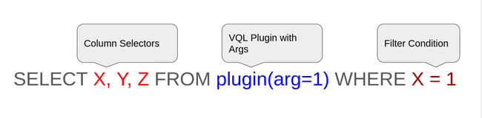
Overview : VQL
Syntax:
Plugin: A code module that generates rows of data for VQL queries based on specified parameters

Slide 7
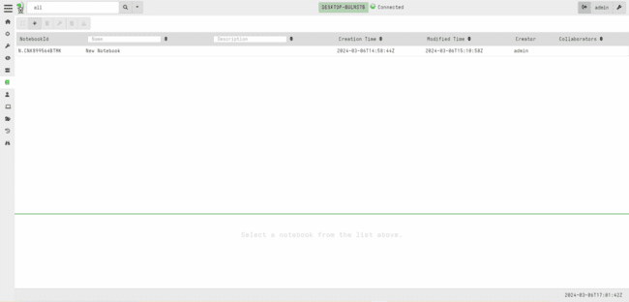
Overview: NoteBook
2. Select “Add notebook”
Select “notebook”
NoteBook: An environment where vql is practiced

Slide 8
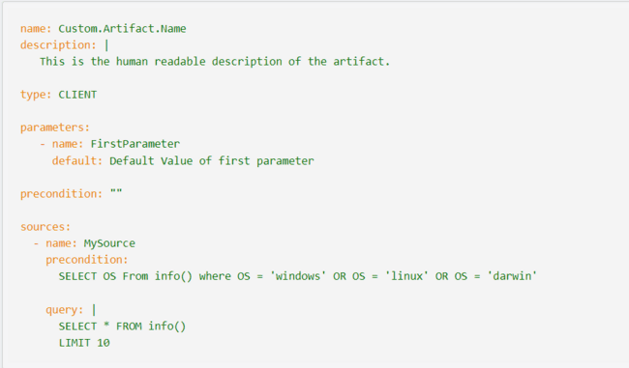
Overview: Artifact
Artifact: A YAML-packaged VQL query for user-friendly data collection.

Slide 9
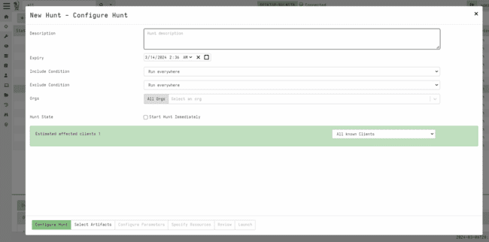
Overview: Hunting (Create)
2. Select “Add Hunt”
Select “Hunt”
3
4
5
Hunting:a logical collection of a one or more artifacts from a group of systems

Slide 10
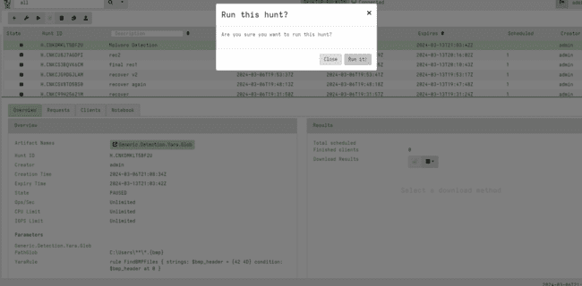
Overview: Hunting (Run)
Hunting:a logical collection of a one or more artifacts from a group of systems

Slide 11
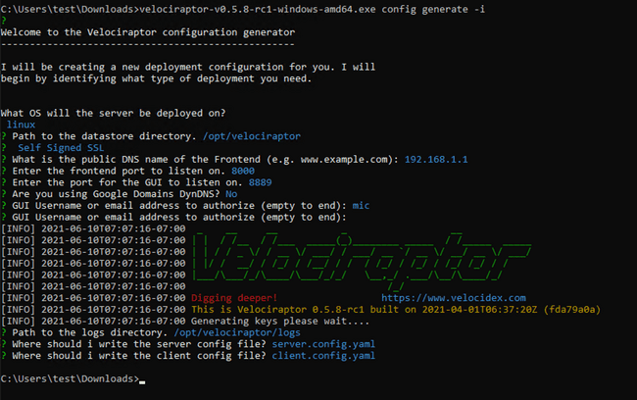
Deployment
Command: velociraptor config generate -i

Slide 12
Deployment
Create Server-package:
Velociraptor.exe --config server.config.yaml user add admin --role administrator
Velociraptor.exe --config server.config.yaml frontend -v
Running clients:
velociraptor --config client.config.yaml client -v
Command: velociraptor config generate -i

Slide 13
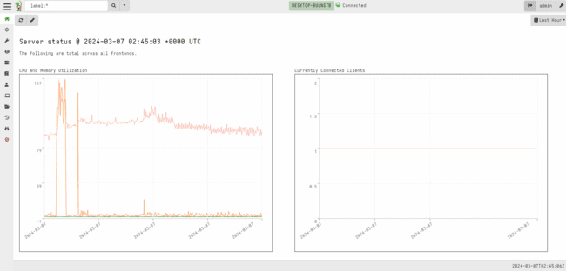
Deployment:DashBoard

Slide 14
Feature-1: Malware Detection
Steps:
Create a Hunt
Add required Artifacts “Generic.Detection.Yara.Glob”
Set Parameters: YaraRule ,Pathglob
Run the hunt
Collect the result
Example:
Set parameters:
C:\users\**\*.{bmp}
yaraRule:
rule FindBMPFiles {
strings:
$bmp_header = {42 4D}
condition:
$bmp_header at 0
}

Slide 15
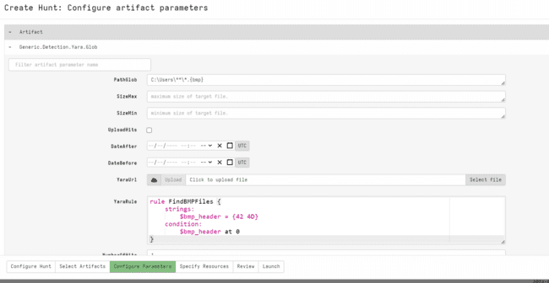
Feature-1: Malware Detection (steps)

Slide 16
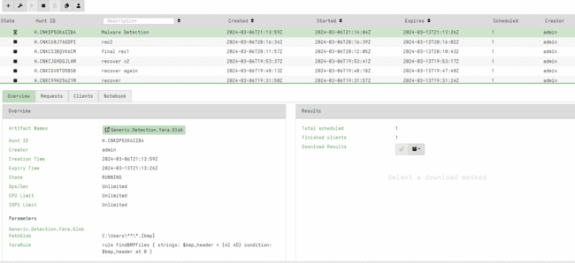
Feature-1: Malware Detection (steps)
To Download Output file

Slide 17
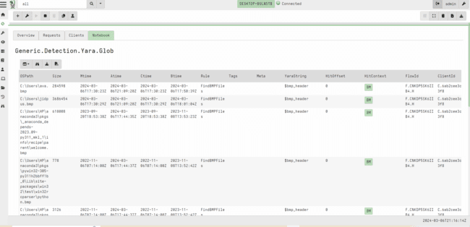
Feature-1: Malware Detection (steps)

Slide 18
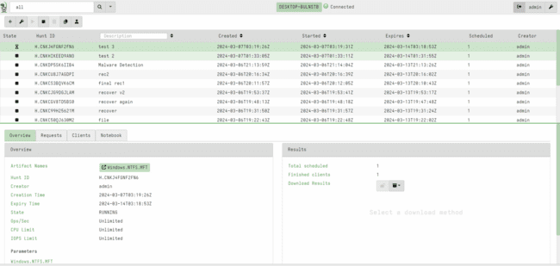
Feature-2: Deleted File Tracing

Slide 19
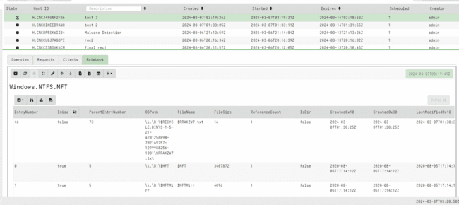
Feature-2: Deleted File Tracing

Slide 20
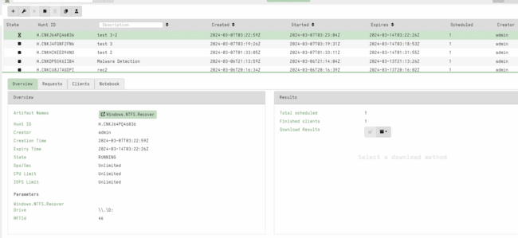
Feature-2: Recover Deleted File

Slide 21
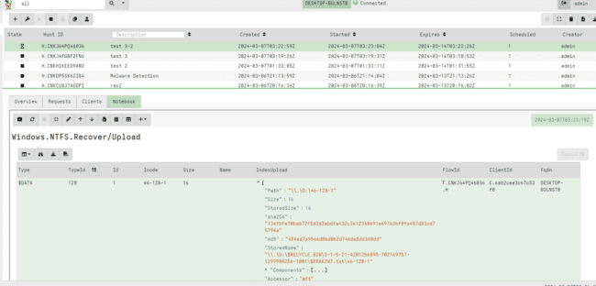
Feature-2: Recover Deleted File

Slide 22
Feature-3: Forensic analysis of Web Browser History
Steps Involved:
Using Artifact Windows.Application.NirsoftBrowserViewer
Collecting Browser history with Velociraptor
Analyzing most visited domains
Analyzing most recently visited sites

Slide 23
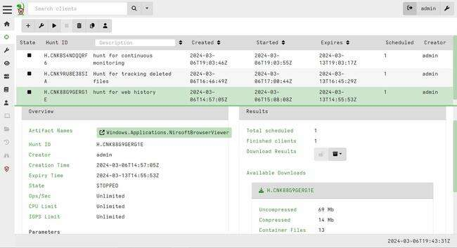
Feature-3: Forensic analysis of Web Browser History
Collecting Web Browser History with artifact

Slide 24
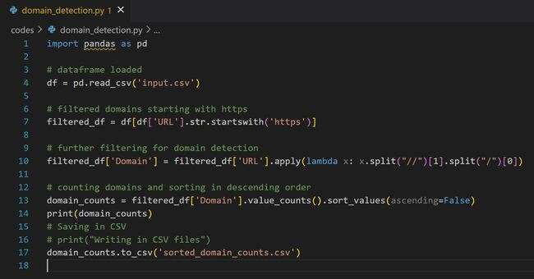
Feature-3: Forensic analysis of Web Browser History
Analyzing most visited domains

Slide 25
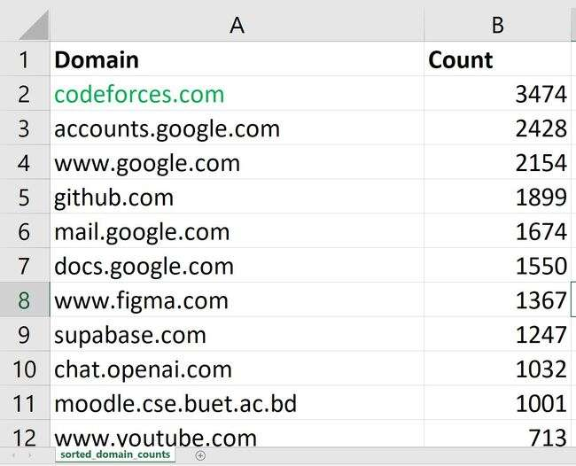
Feature-3: Forensic analysis of Web Browser History
Analyzing most visited domains (Result)

Slide 26
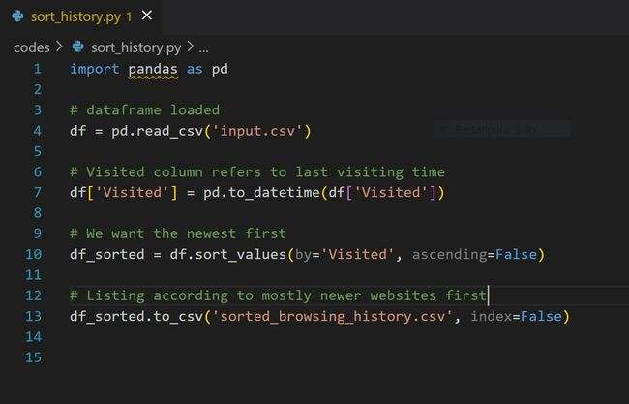
Feature-3: Forensic analysis of Web Browser History
Analyzing most recently visited sites

Slide 27
Feature-3: Forensic analysis of Web Browser History
Can be useful for:
Temporal Patterns of Activity
Frequency and duration of visits
Social Media and communication tool usage
File Downloads or visited
Search Queries
Geolocation information
Use of cloud storage and external services
Access to unauthorized or malicious sites

Slide 28
Feature-4: Continuous Monitoring and Detection of Unsuccessful Login
Steps followed:
Added a custom artifact for detecting Event Id = 4625 (Unsuccessful Login in Windows)
Whenever an unsuccessful login attempt is detected, it is automatically shown under the ‘notebook’ tab.

Slide 29
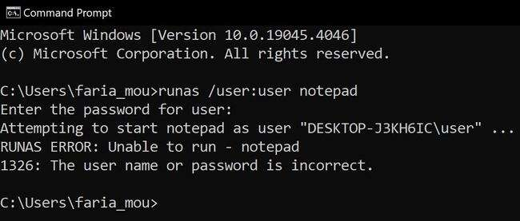
Feature-4: Continuous Monitoring and Detection of Unsuccessful Login
Unsuccessful Login at Desktop of faria-mou:

Slide 30
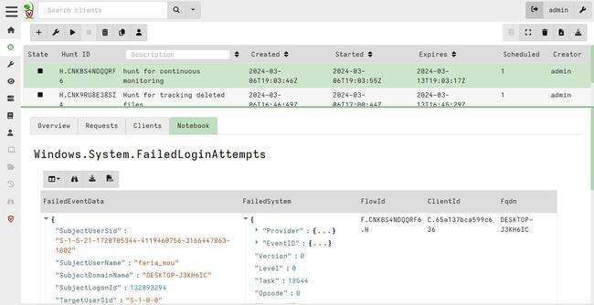
Feature-4: Continuous Monitoring and Detection of Unsuccessful Login
Unsuccessful Login Detected for user faria-mou:

Slide 31
Overview: Artifact

Slide 32
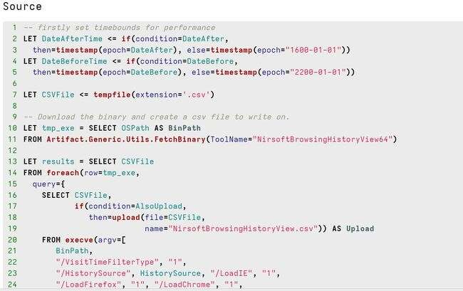
Overview: Artifact (NirsoftWindowViewer)

Slide 33
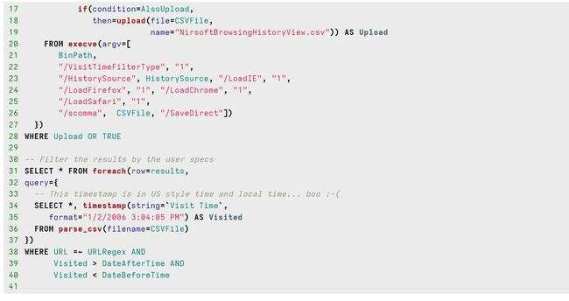
Overview: Artifact (NirsoftWindowViewer)

Slide 34
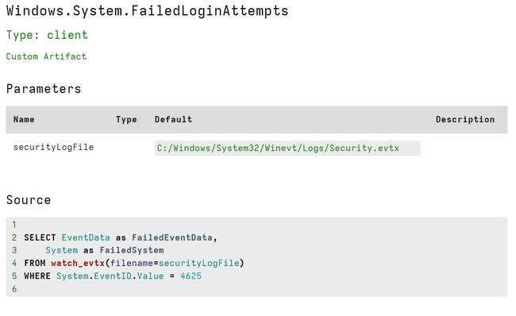
Overview: Artifact
Windows.System.FailedLoginAttempts

Slide 35
Thank You

